Slide 1
Numbers Don’t Lie:
Creating an Improved High School Sports Rating System
Jeff Heath, Will Britt, Shelby Montgomery, and Jackson Norris
Centre College
Notes:
Will

Slide 2
Background
Kentucky High School Sports Ratings Systems
Associated Press (human) polls contain bias
Litkenhous ratings created in 1934
Lacks transparency
Simply playing an inferior opponent harms a good team’s rating
Outdated
Challenges to computer-based rating methodologies
Notes:
Will
Examples of exceptions: Loss in personnel- Oregon in 2007 was 8-1 and ranked #2 and then lost their QB Dennis Dixon, causing them to lose the last three games of their season. Thus, when Arizona and UCLA beat Oregon without Dixon, the ranking system gave them more credit for wins beyond what they should've been credited for
Weather- A strong team might barely win in an ice storm and be adversely affected by the system that only judges on performance
Psychological- Rivalries, the last game of a head coach, tragedy weighing on a team have all caused big upset wins but the win or loss is unfairly judged the same by the computer.
Most rating methodologies fail to consider
Major losses in team personnel
Environment during game (weather, expulsions, etc.)
Psychological factors

Slide 3
Goals of our Project
Create a system that rates a team’s performance by combining three different methodologies:
Elo method (1960)
Massey method (1995)
Colley method (2002)
Notes:
Will

Slide 4
Guiding Principles of our Ratings System
Wins and margin of victory incorporated into the rating
Maximum reward for beating a team is set at a margin of 36 points (in football)
Does not reward teams that run up the score
Ratings should account for Strength of Schedule and Home Field Advantage
Heavily favored teams that win by substantial margins should not be penalized
Notes:
Will

Slide 5
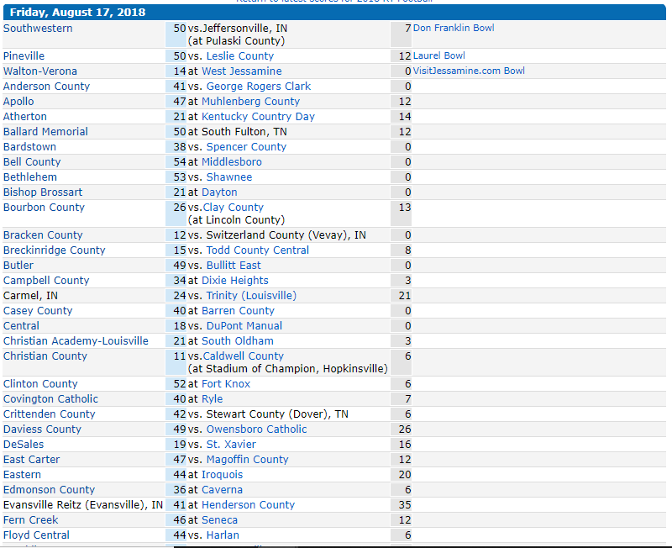
Data Collection
Webscrape weekly scoreboard files
Extract teams and relevant game info (date, score, location, and team ids)
Create matrices of game information for every game in the season (winners, locations, overtimes, forfeits, out-of-state records, etc.)
Notes:
Will

Slide 6
Massey Method
G ⇒ n x k matrix (n = # of games, k = # of teams)
Assign a 1 for winning team, -1 for the losing team
PD ⇒ n x 1 column vector of point differentials (all positive)
Computing the Ratings
G * Ratings = PD
Ratings = inv( G^{T} * G ) * G^{T} * PD
Difference in ratings between two teams is their predicted point margin

Slide 7
Massey Method Example
G =
1 -1 0
0 1 -1
1 0 -1
PD =
10
5
4
Ratings =
4.6667 (A)
-1.6667 (B)
-3.0000 (C)
A beats B by 10 points
B beats C by 5 points
A beats C by 4 points
Ratings = inv( G^{T} * G ) * G^{T} * PD

Slide 8
Colley Method
Every team begins season with a rating of 0.5
S ⇒ k x k matrix (k = # of teams)
Keeps track of the schedule
X ⇒ k x 1 column matrix keeping track of each team’s results
Computing the Ratings
S * Ratings = X
Ratings = S ⁻¹ * X
Notes:
Each team effectively starts the season with a win and a loss, to avoid having undefeated teams
automatically at the top (and winless teams at the bottom) regardless of schedule strength.
Recognized by BCS

Slide 9
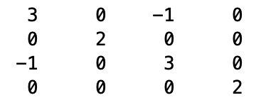
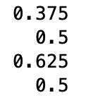
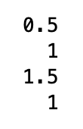
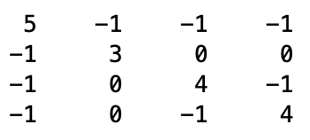
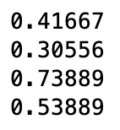

Colley Example
Team A loses to Team C
Multiple games are played (C beats A; A beats B; C beats D; D beats A)
S
Ratings
X
Notes:
For the Colley matrix, A, the diagonal starts at 2 and each column and row represents a team. When Team A plays Team C, the diagonal entry increases by 1 and 1 is subtracted from the entry corresponding to that team

Slide 10
Elo Method
Parameterized rating system
Every team starts with the same rating
Create a win probability for every game
Ratings change based on the difference between the result (1 or 0) and the win probability
Popular
Developed and used for chess ratings
Used for 538’s sports ratings

Slide 11

Elo Foundation
Notes:
Jackson Norris

Slide 12
Initializing Elo Ratings
KY has 6 classes in Football based on school enrollment
Overall team ratings for each class vary somewhat consistently
Year-to-year correlation for individual teams
In order to accelerate convergence of Elo ratings:
We initialize them with the previous year’s ratings regressed to the mean ratings of their class.
Notes:
Jackson

Slide 13
Why three systems?
Massey
Factors in margin of victory
Rating of losing team would increase if they lose a close game to a superior opponent
Colley
Only factors in aggregate record and strength of schedule
Elo
Each game only affects ratings of those two teams
Winning team’s rating always increases
Losing team’s rating always decreases

Slide 14
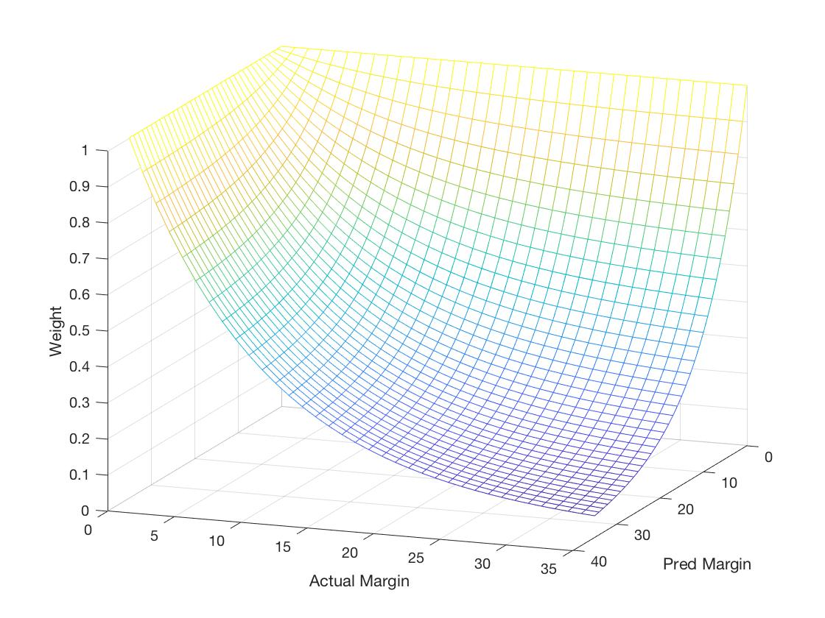
Margin-Based Weights
Used for Massey and Colley ratings
Games in which heavily favored teams winning by substantial margins are given small weights
A true upset is given the maximum weight of 1
The ratings of a heavily favored team that wins by a small margin will likely go down, but not as much as if they had lost
Notes:
Due to a large disparity between the best and worst teams and wanting to prevent heavily favored teams from being penalized, we incorporate margin based weights and time based weights on the ratings.
We use a weight function that decreases exponentially with the product of the predicted and actual margins whenever the favored team wins. Both the favored team and the predicted margin will be determined previously Go through bullets and point to places on the screen

Slide 15
Home Field Advantage and Optimizing Parameters
Used data fitting to calculate the number of points attributed to HFA (~2.3 points)
Massey: adjust point differential by subtracting HFA from Home team
Colley: additional benefit for Road win vs. a Home win
Elo: correlate Elo points to game points
All other parameters were optimized by training on first 2/3 of season and maximizing the predictions on the remaining games
Notes:
Jackson

Slide 16
Our Aggregate System
For each set of ratings (Massey, Colley, Elo):
Rescaled ratings from (roughly) 0 to 100
Rescaled ratings of 0 and 100 are equivalent to the historical average of the lowest and highest team ratings, respectively
Our Aggregate rating = mean of all 3 rescaled ratings
Notes:
Will

Slide 17
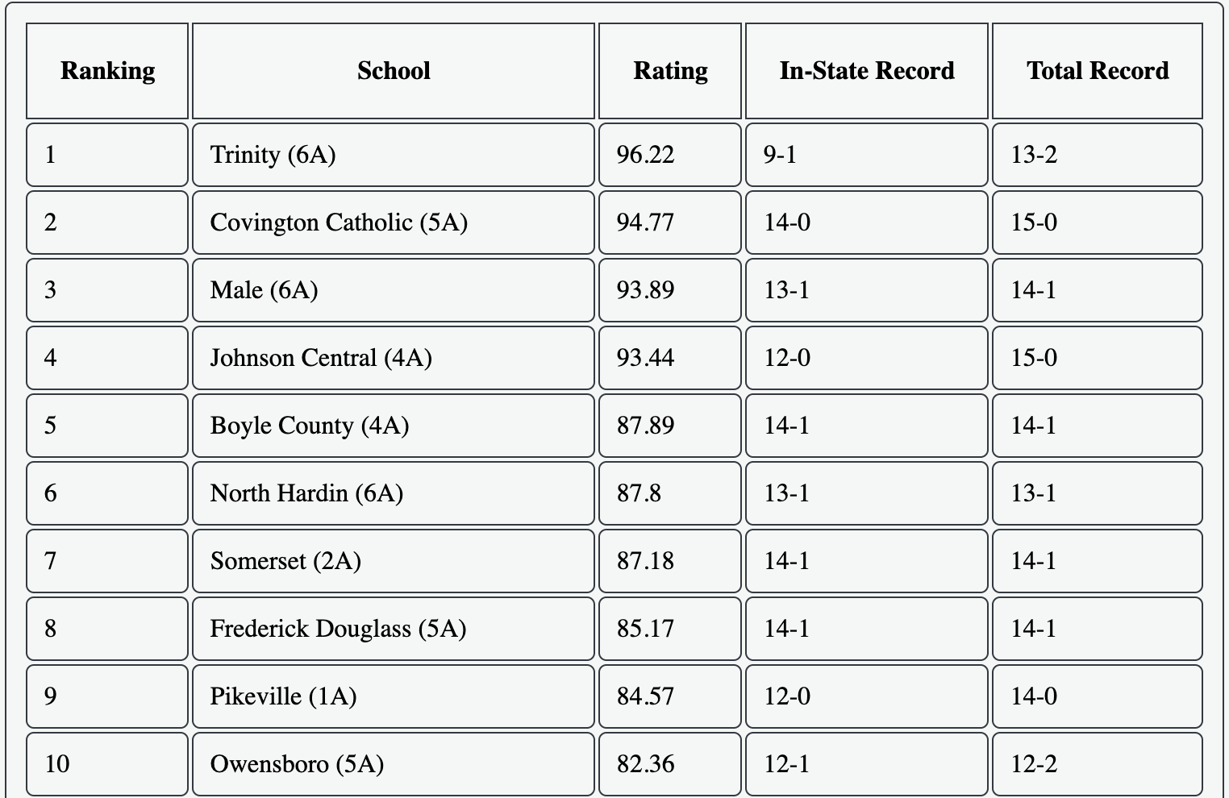
Notes:
Will

Slide 18
Future Work
Validate our rating methodology vs. other methodologies for recent college football data
Develop and optimize ratings for boys and girls basketball
Finish web design and automatically publish data
Spread the word!
karpratings.com
Notes:
Will

Slide 19


Acknowledgements
Funding
Centre College
LSAMP KY-WV Grant
Inspiration
Massey, Colley, Elo
Nate Silver
Drew Pasteur

Slide 20
Questions?

